Slide 1
Discrete Mathematics
Spring 2020
Yuan Ze University

Slide 2
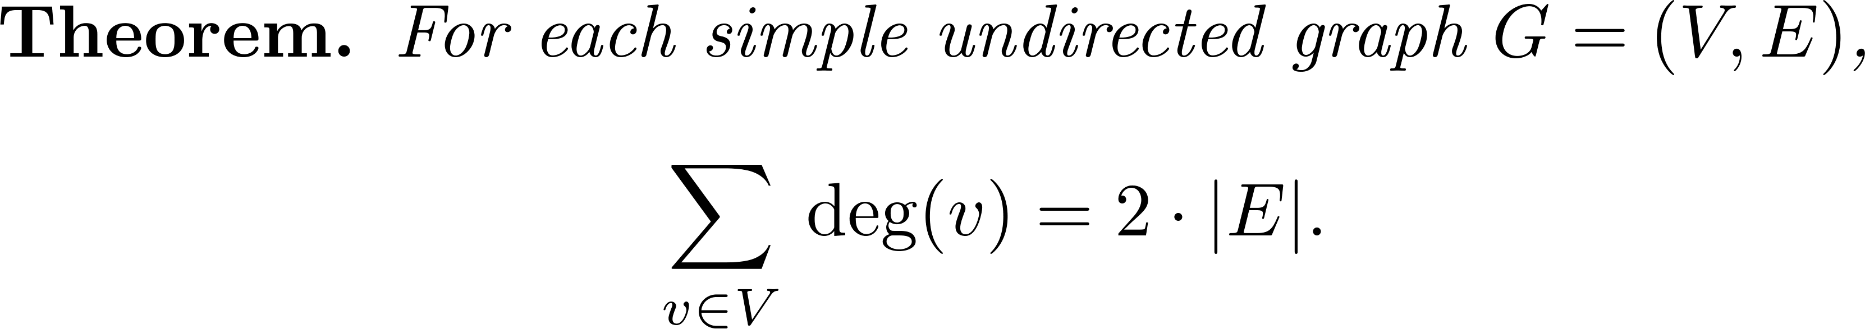
A theorem
v₃
v₁
v₅
v₂
v₄

Slide 3
So…

Slide 4
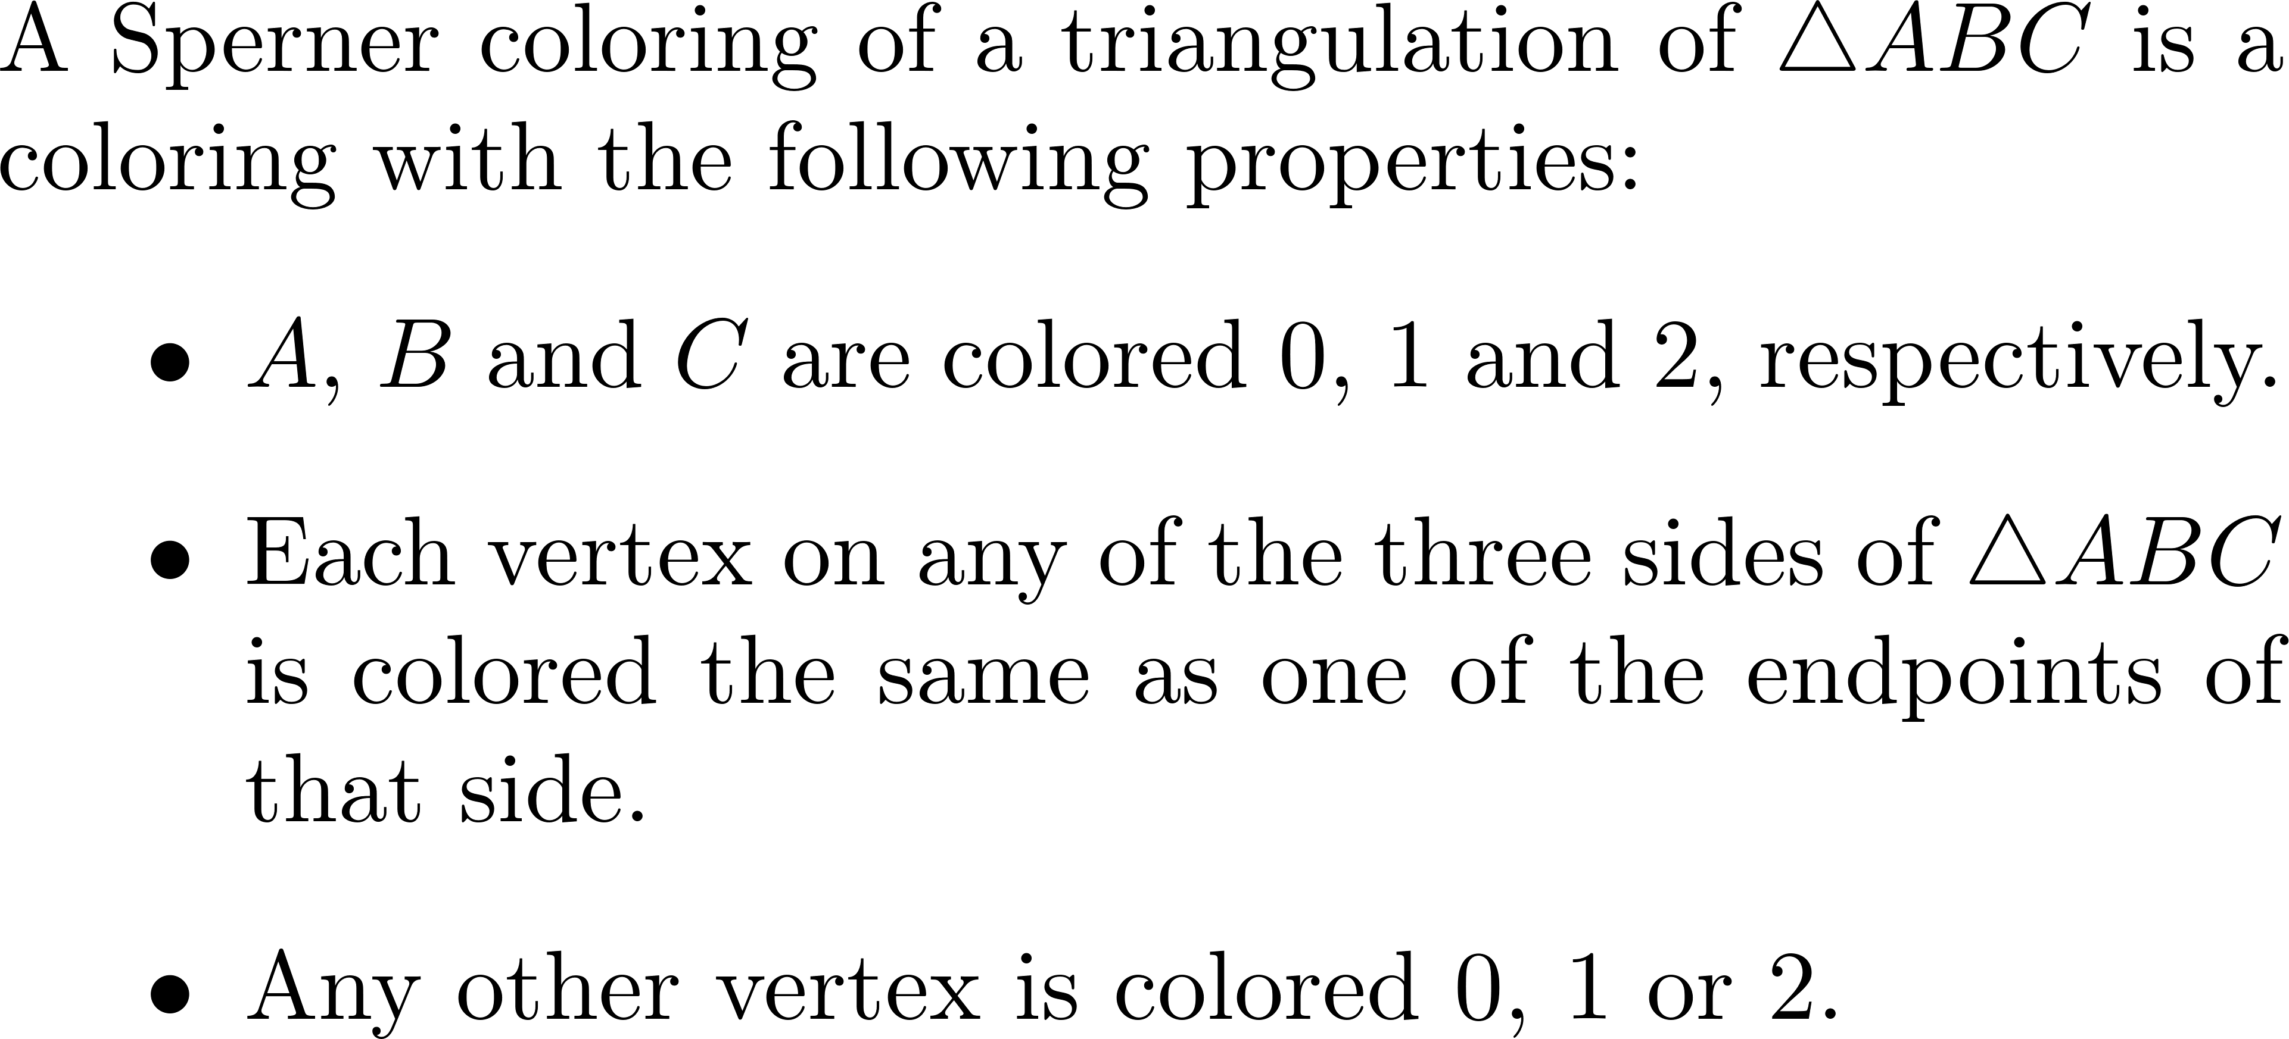
Sperner colorings

Slide 5
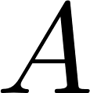

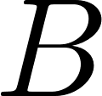
Sperner’s lemma
0
0
2
2
1
0
2
0
0
1
1
1
2

Slide 6
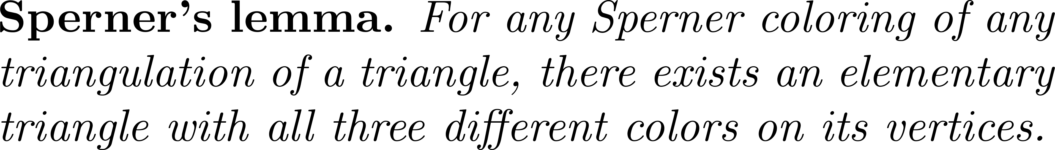
Sperner’s lemma

Slide 7
A new graph
0
0
2
2
1
0
2
0
0
1
1
1
2

Slide 8
So…
The outer face, now a vertex, must have an odd degree!
Some inner vertex must also have an odd degree because the degree sum is even.
0
1
0
2
2
1
0
1
0
1
0
0

Slide 9
Yes!
There must be a triangle with all 3 colors!

Slide 10
Proved!

Slide 11
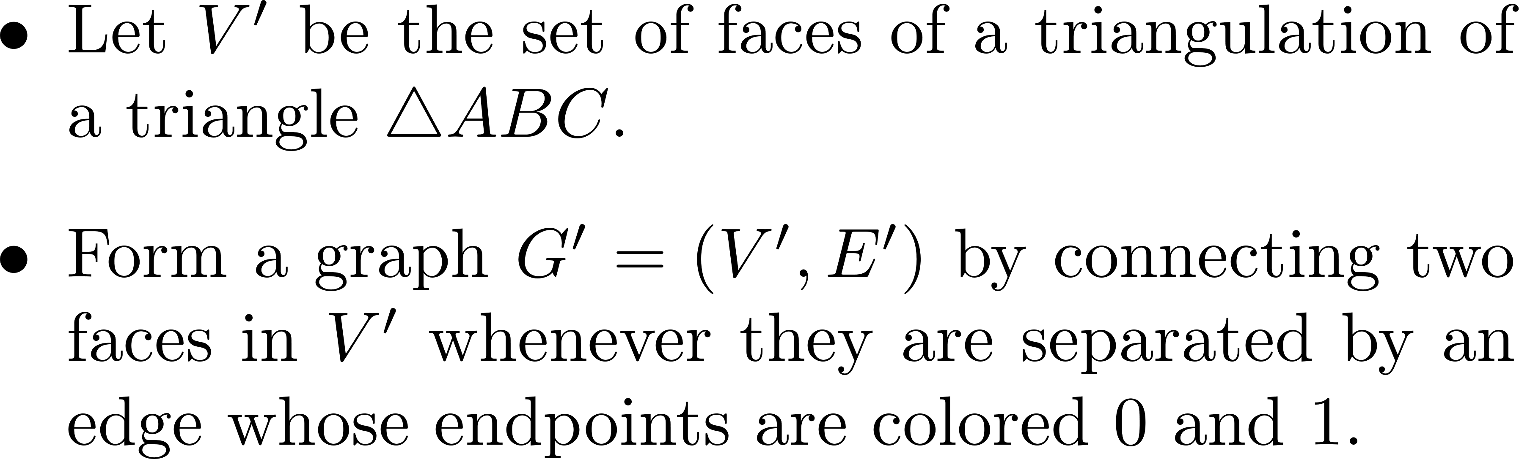
A written proof (1/2)

Slide 12
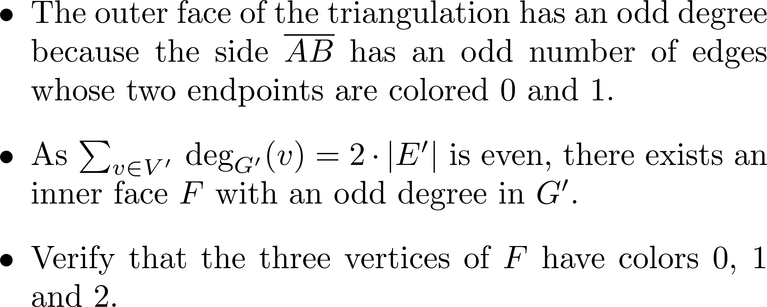
A written proof (2/2)

Slide 13
Quiz
A slightly different proof

Slide 14
Does this work?
0
0
2
2
1
0
2
0
0
1
1
1
2

Slide 15
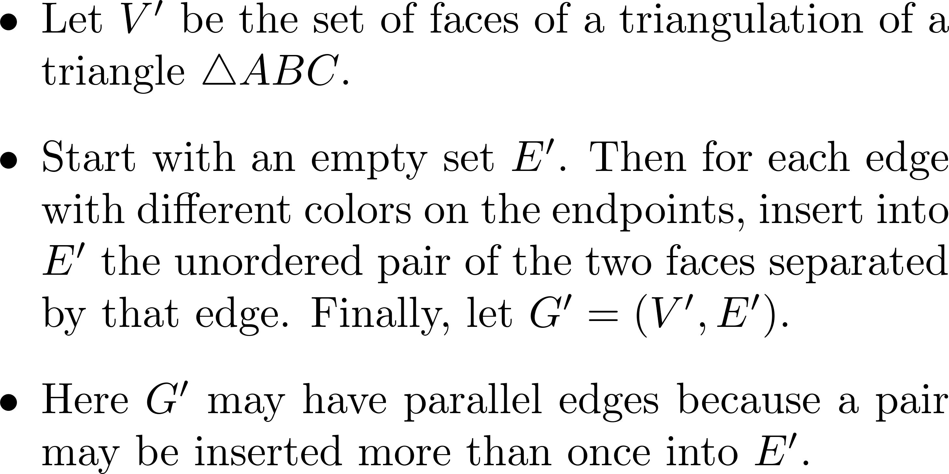
A modified proof (1/2)

Slide 16
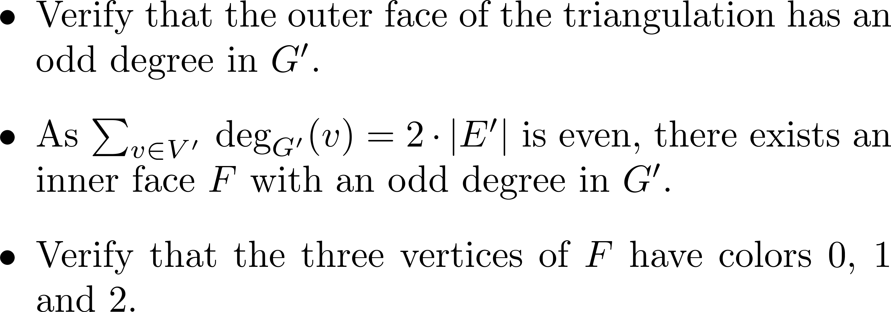
A modified proof (2/2)

Slide 17
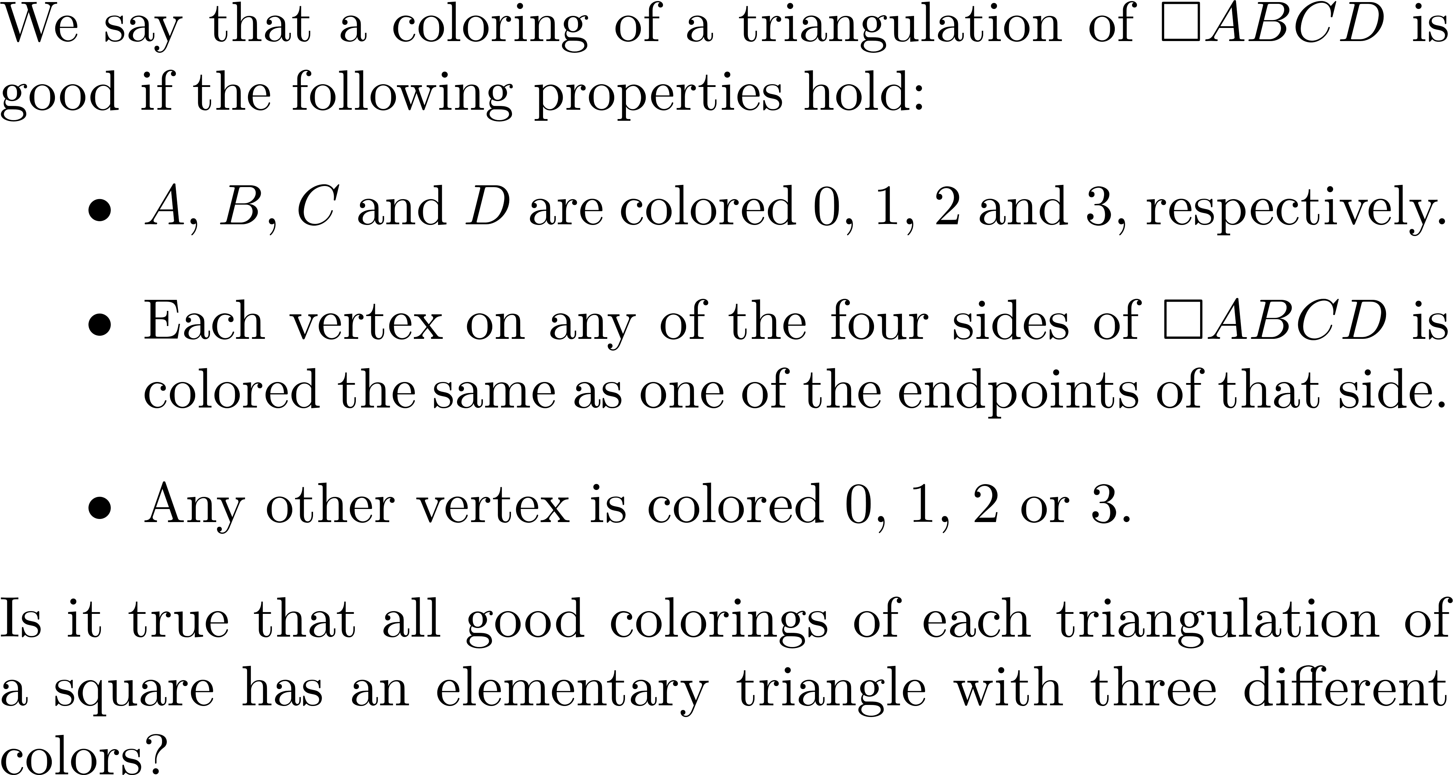
Quiz

Slide 18
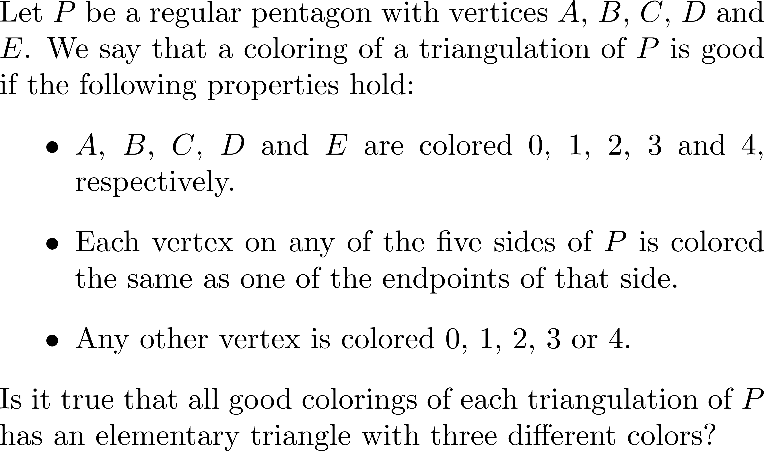
Quiz

Slide 19
Comments and questions?

Slide 20
Game theory
A glimpse

Slide 21
What is a finite game?
There are a finite set of players and a finite set of pure strategies for each player.
The payoff of each player can be determined by the pure strategies played by all players.
 | 剪刀 | 石頭 | 布
剪刀 | 0/0 | -1/1 | 1/-1
石頭 | 1/-1 | 0/0 | -1/1
布 | -1/1 | 1/-1 | 0/0

Slide 22
Pure-strategy Nash equilibrium
Player 1 plays strategy 1, and player 2 plays strategy 2
Unilateral change of strategy brings no benefit
 | 1 | 2 | 3
1 | 8/-8 | 5/-5 | 7/-7
2 | 4/-4 | 3/-3 | -2/2
3 | -4/4 | 3/-3 | 1/-1

Slide 23
Sometimes…
A pure-strategy Nash equilibrium is nonexistent…
 | 剪刀 | 石頭 | 布
剪刀 | 0/0 | -1/1 | 1/-1
石頭 | 1/-1 | 0/0 | -1/1
布 | -1/1 | 1/-1 | 0/0

Slide 24
Mixed strategies
A player’s mixed strategy is a distribution over her pure strategies.
For example, I play rock, scissors and paper with probabilities 70%, 10% and 20%, respectively.

Slide 25
An example
Player 1 plays strategies 1 and 2 with probabilities 70% and 30%, respectively. Player 2 plays strategies 1 and 2 with probabilities 30% and 70%, respectively.
Any unilateral change to the mixed strategy brings no benefit in expectation.
 | 1 | 2
1 | 1/-1 | 0.82/-0.82
2 | 0.58/-0.58 | 1/-1

Slide 26
Mixed-strategy Nash equilibrium
The players’ mixed strategies form a mixed-strategy Nash equilibrium if no single player can get a strictly higher expected payoff by deviating from her current mixed strategy.
When the players play according to a mixed-strategy Nash equilibrium, no one has the incentive to change.

Slide 27
Surprisingly…

Slide 28
In contrast…
A pure-strategy Nash equilibrium is nonexistent for many finite games.

Slide 29
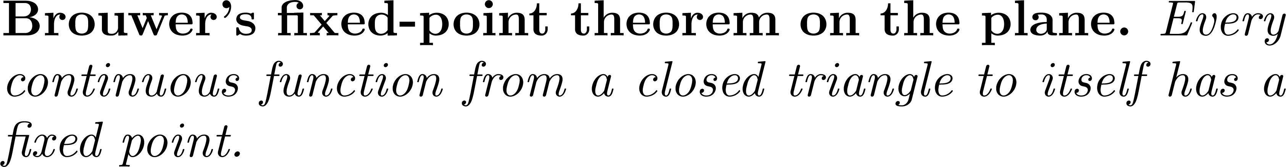


Brouwer’s fixed-point theorem ☺

Slide 30
Fixed point?

Slide 31
A glimpse
The two-dimensional version of Sperner’s lemma can be used to prove Brouwer’s fixed-point theorem on the plane.
The analog is true in higher dimensions.
Brouwer’s fixed-point theorem can be used to prove Nash’s theorem.

Slide 32
Comments and questions?

